Slide 1
Dissertation Committee Meeting
Eric Liao
December 12, 2024

Slide 2
Today’s Goals
Review the progress of dissertation thesis
Go over details of chapter 3 (West Nile Disease Prediction)
Review timeline for potential spring 2025 defense

Slide 3
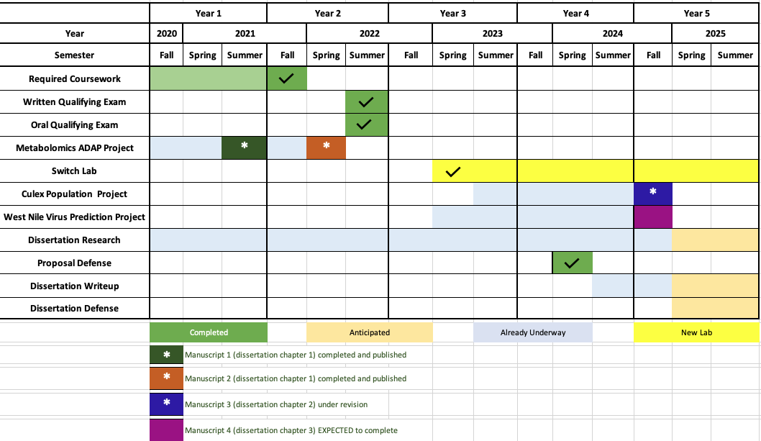
Project Timeline

Slide 4
Summary
Chapter 1:
Metabolomics projects with Dr. Du. (2 paper published, includes one co-1st author paper)
Chapter 2:
Population genetics of Culex tarsalis. (Paper under revision with Genome Biology and Evolution)
Chapter 3:
West Nile Virus Prediction (Paper in Prep.)

Slide 5
Paper List
Aleksandr Smirnov, Yunfei Liao, Eoin Fahy, Shankar Subramaniam, Xiuxia Du*, ADAP-KDB: A Spectral Knowledgebase for Tracking and Prioritizing Unknown GC–MS Spectra in the NIH’s Metabolomics Data Repository, Analytical Chemistry 2021 93 (36), 12213-12220, DOI: 10.1021/acs.analchem.1c00355
Smirnov, Aleksandr ⁺, Yunfei Liao ⁺, and Xiuxia Du. “Memory-Efficient Searching of Gas-Chromatography Mass Spectra Accelerated by Prescreening.” Metabolites 12, no. 6 (2022): 491. https://doi.org/10.3390/metabo12060491.
Yunfei Liao, Touhid Islam, Rooksana Noorai, Jared Streich, Christopher Saski, Lee W. Cohnstaedt, Elizabeth A. Cooper, Climate Adaptation and Genetic Differentiation in the Mosquito Species Culex tarsalis, Genome Biology and Evolution, In Revision
Yunfei Liao, John Humphreys, Lee W. Cohnstaedt, Elizabeth A. Cooper, Machine Learning Prediction of West Nile Virus in California, In Prep.
⁺ Co-first author

Slide 6
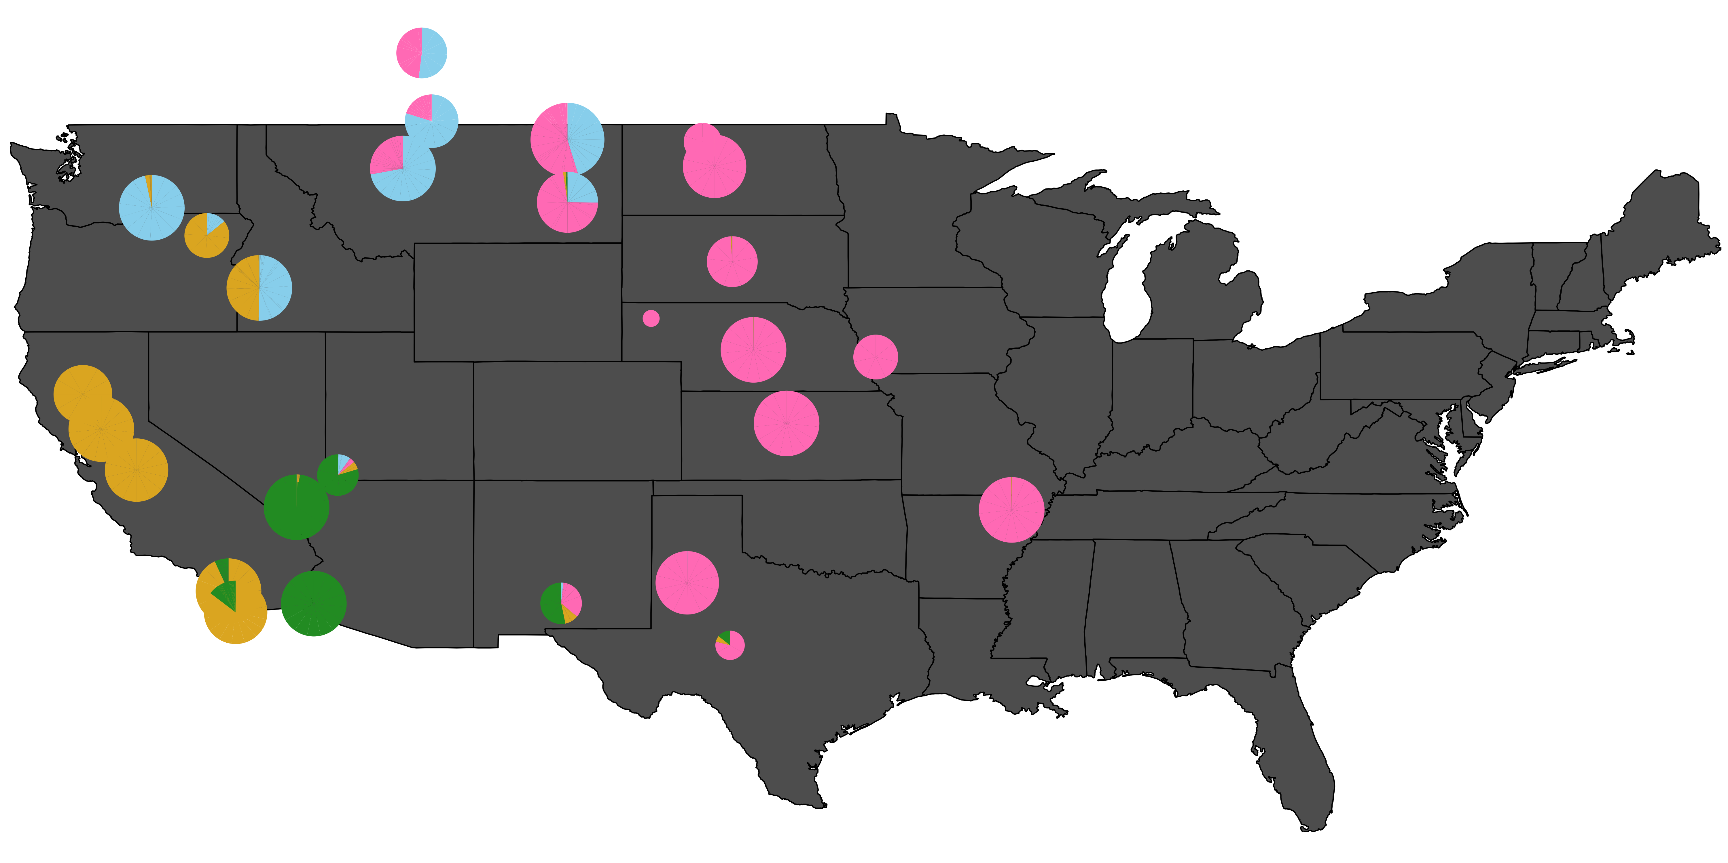
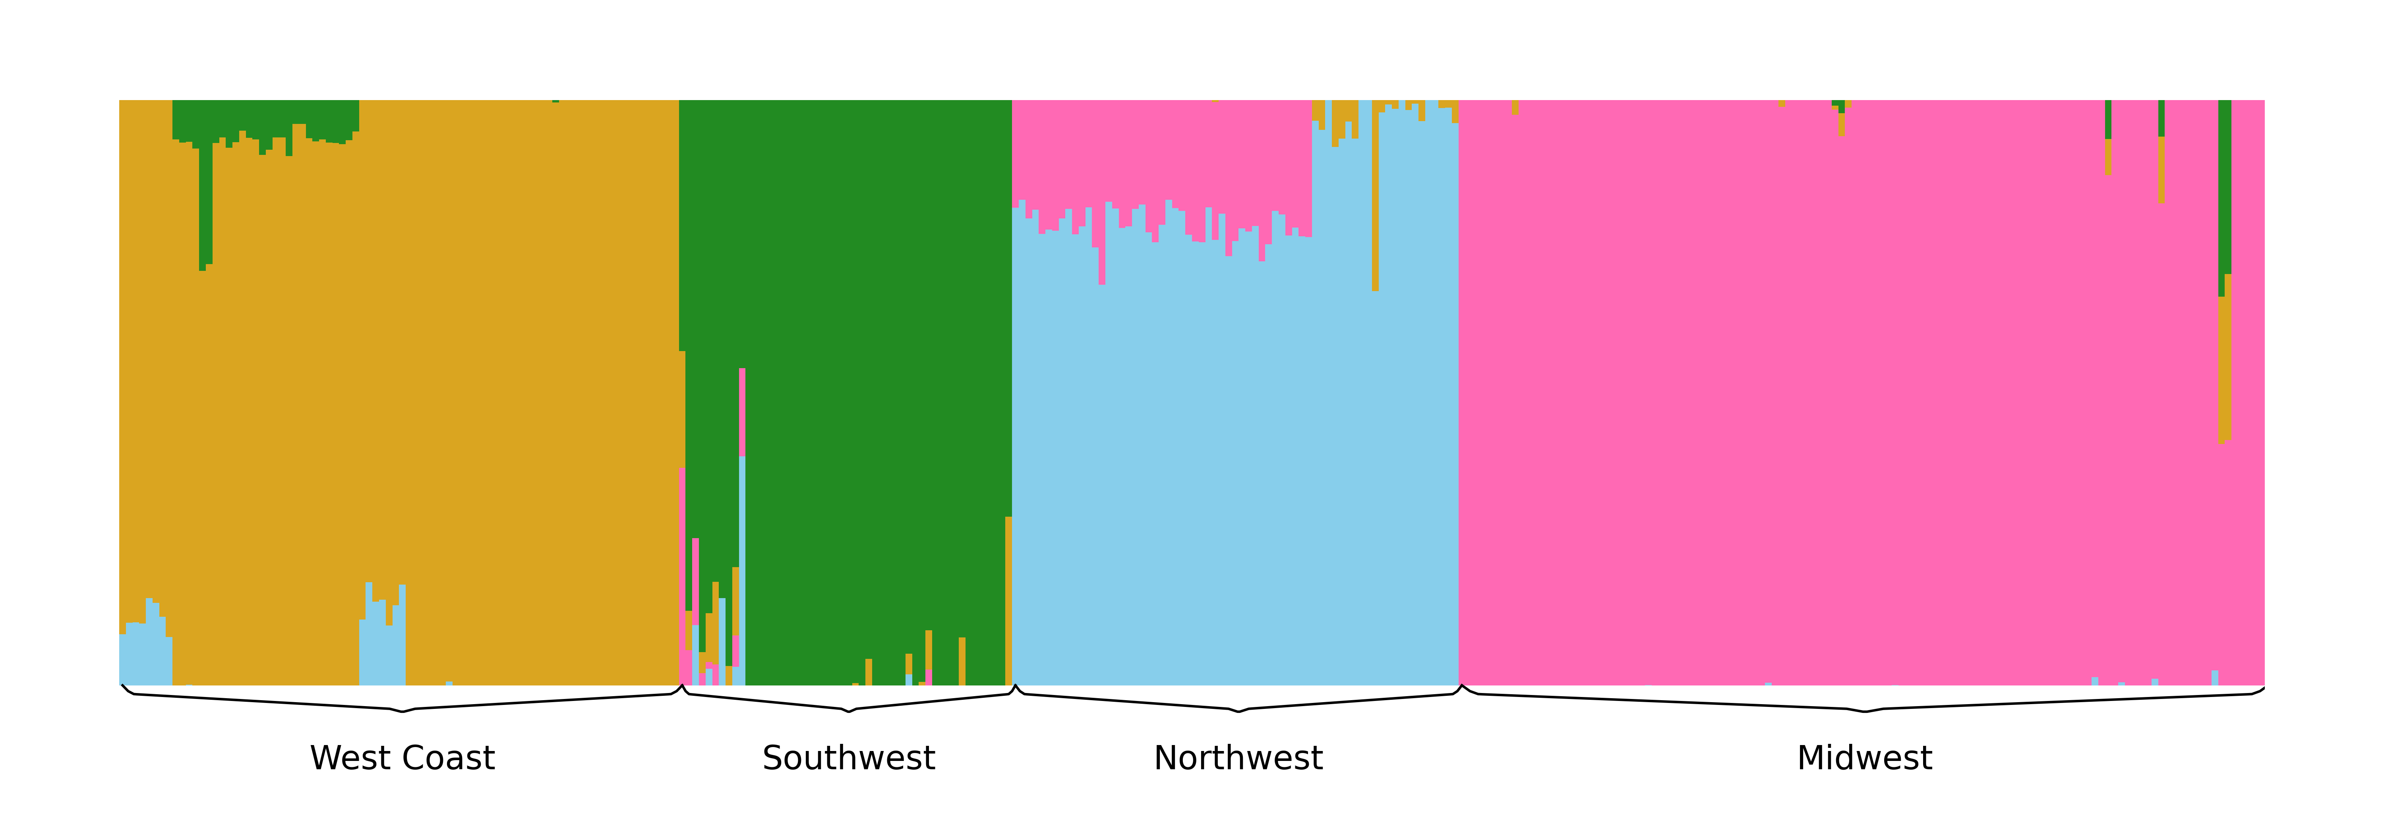
Chapter 2: Population Genetics of Cx. tarsalis
Submitted the Paper to Genome Biology and Evolution
Paper is under revision status, anticipate to submit in January
Working on a new data. Trying to call SNPs from old Sequence data, then run the same pipeline to get the results (potentially a 5th paper if it works)
Figure 1: Admixture Results

Slide 7
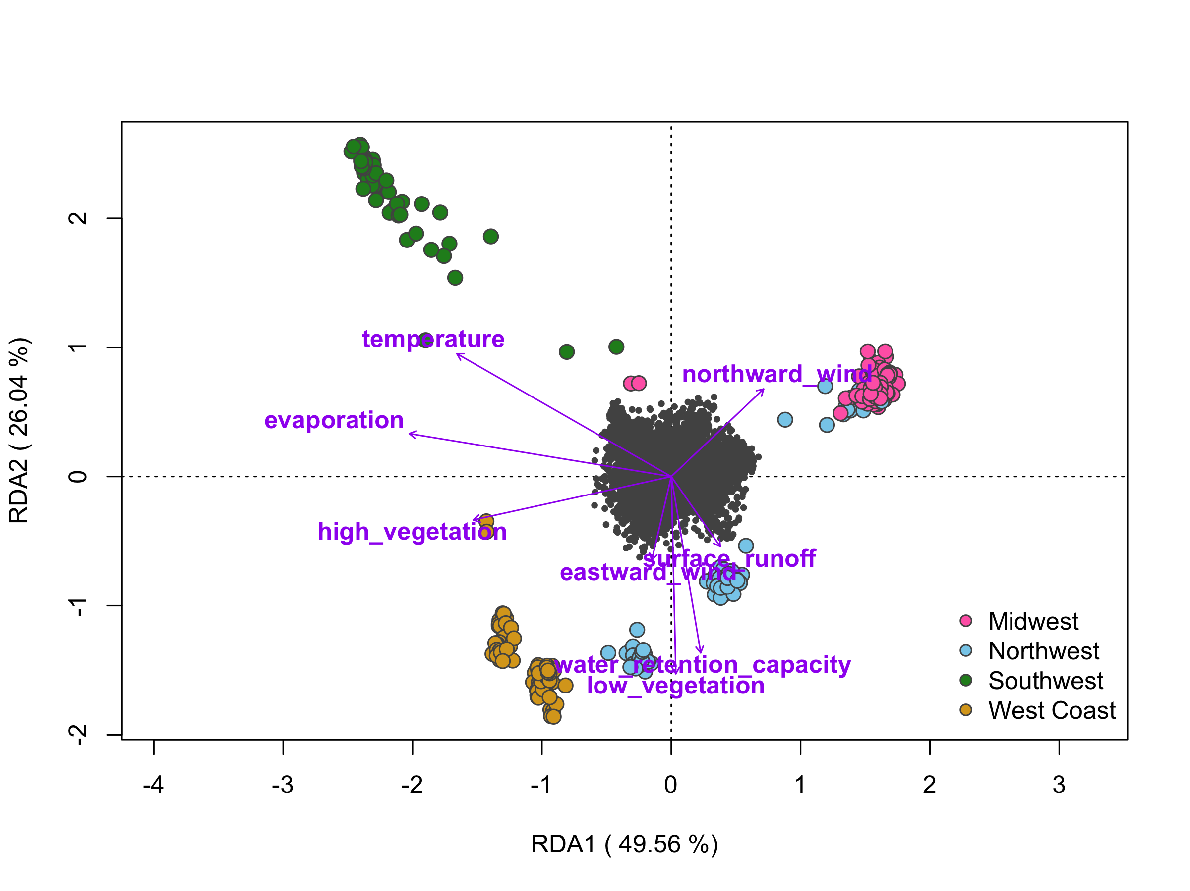
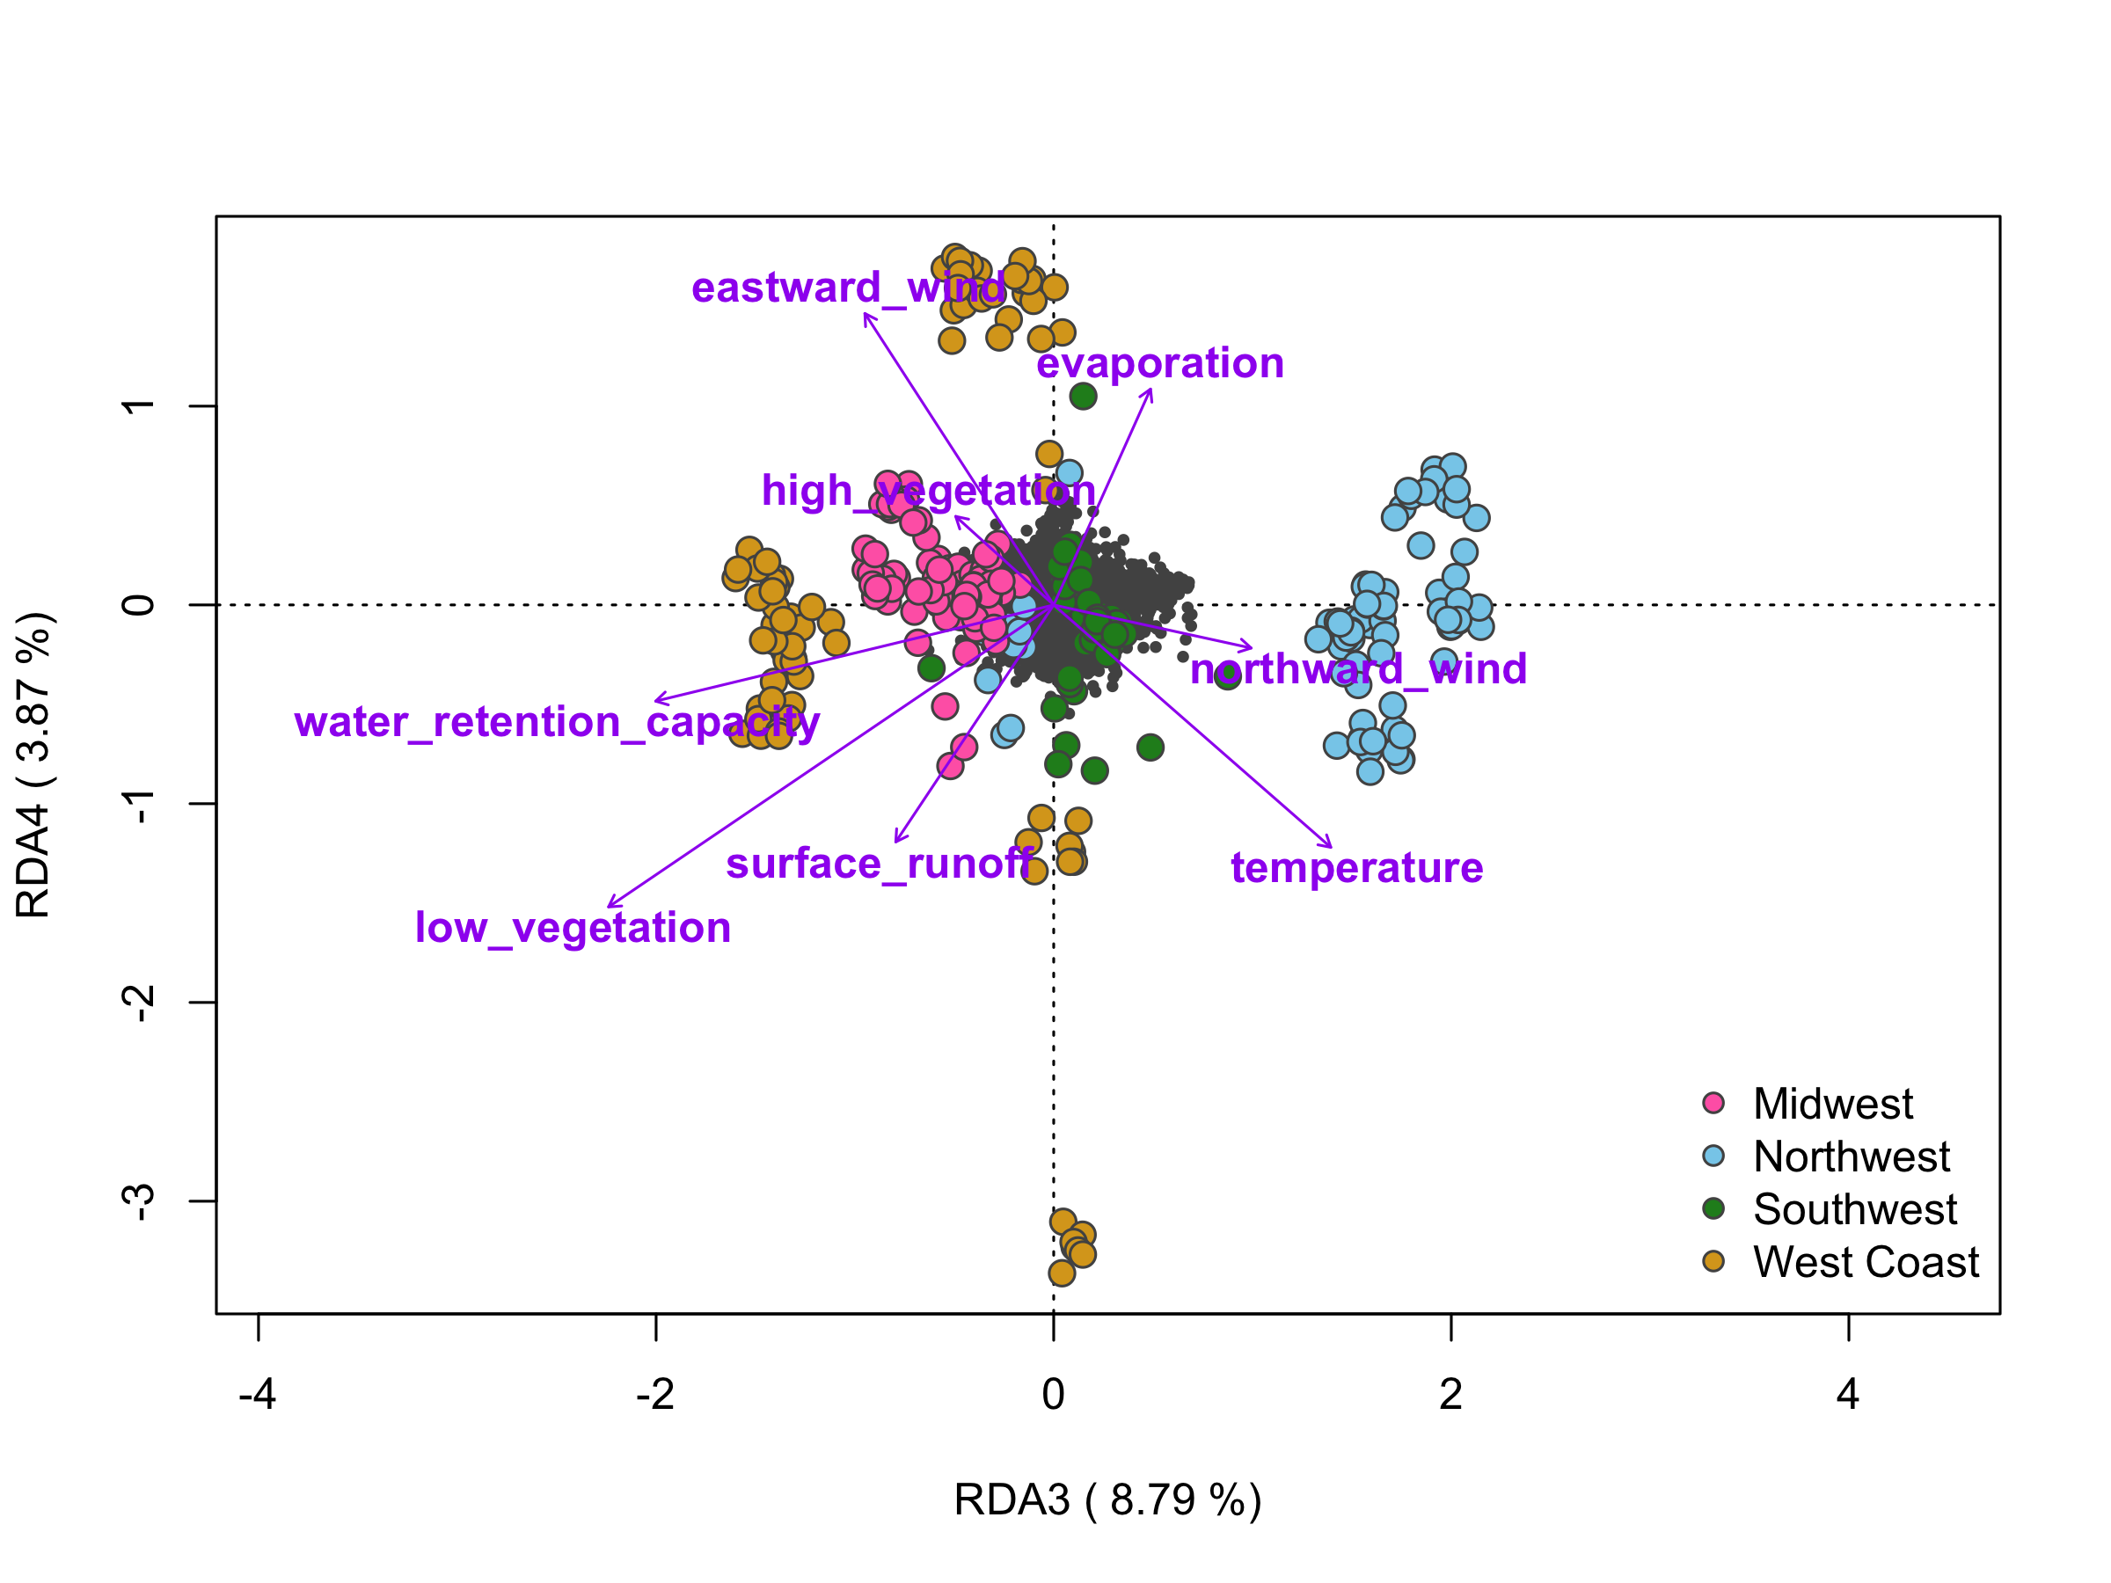
Different Environmental Vectors Drive Sample Divergence in Different Regions
Figure: Environmental Correlates of Genetic Variation in Cx. tarsalis Across Diverse North American Regions. Panels left and right display the relationship between environmental factors and the distribution of Cx. tarsalis
Notes:
“Different environmental vectors drive sample divergence in different regions”
These two plots focus on the sample locations against the environmental vectors. The angle between the sample and environmental vector can tell us the relationship. The smaller the angle is, the stronger the correlation is between the environmental vector and samples.
The longer the vector is, the stronger effect the vector will be.

Slide 8
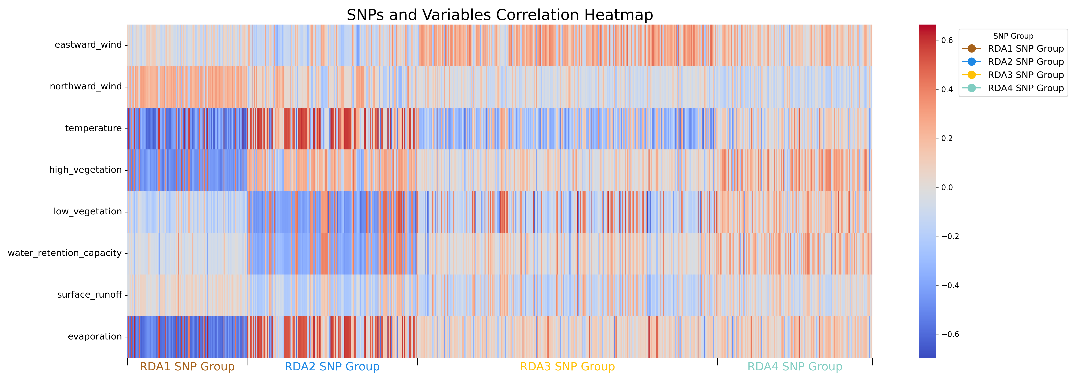
Candidate SNPs Exhibit Adaptation to Complex Environmental Variables
Figure: Heatmap of Candidate SNPs Associated with Environmental Adaptation, Identified by RDA Axes 1 to 4

Slide 9
One of the top genes is Period Circadian Protein
Adaptive Gene | Total SNPs | Nonsynonymous |  |  | Synonymous
 |  | Total | Tolerated | Deleterious | Total | Tolerated | Deleterious
Ct.00g025080 | 3 | 1 | 1 | 0 | 2 | 2 | 0
Ct.00g026900 | 8 | 0 | 0 | 0 | 8 | 8 | 0
Ct.00g030230 | 2 | 1 | 1 | 0 | 1 | 1 | 0
Ct.00g032480 | 1 | 0 | 0 | 0 | 1 | 1 | 0
Ct.00g049290 | 3 | 2 | 1 | 1 | 1 | 1 | 0
Ct.00g051300 | 3 | 2 | 2 | 0 | 1 | 1 | 0
Ct.00g062900 | 3 | 0 | 0 | 0 | 3 | 3 | 0
Ct.00g064410 | 2 | 0 | 0 | 0 | 2 | 2 | 0
Ct.00g095350 | 1 | 0 | 0 | 0 | 1 | 1 | 0
Ct.00g154760 | 2 | 0 | 0 | 0 | 2 | 2 | 0
Ct.00g176220 | 6 | 1 | 1 | 0 | 5 | 5 | 0
Ct.00g179740 | 2 | 0 | 0 | 0 | 2 | 2 | 0
Ct.00g237940 | 3 | 0 | 0 | 0 | 3 | 3 | 0
Ct.00g238000 | 4 | 1 | 0 | 1 | 3 | 3 | 0
Ct.00g280270 | 5 | 2 | 2 | 0 | 3 | 3 | 0
Ct.00g280280 | 3 | 2 | 2 | 0 | 1 | 1 | 0
Ct.00g290200 | 2 | 0 | 0 | 0 | 2 | 2 | 0
Period Circadian Protein (circadian rhythms and diapause adaptation)
16
Notes:
The circadian rhythm is also essential for diapause

Slide 10
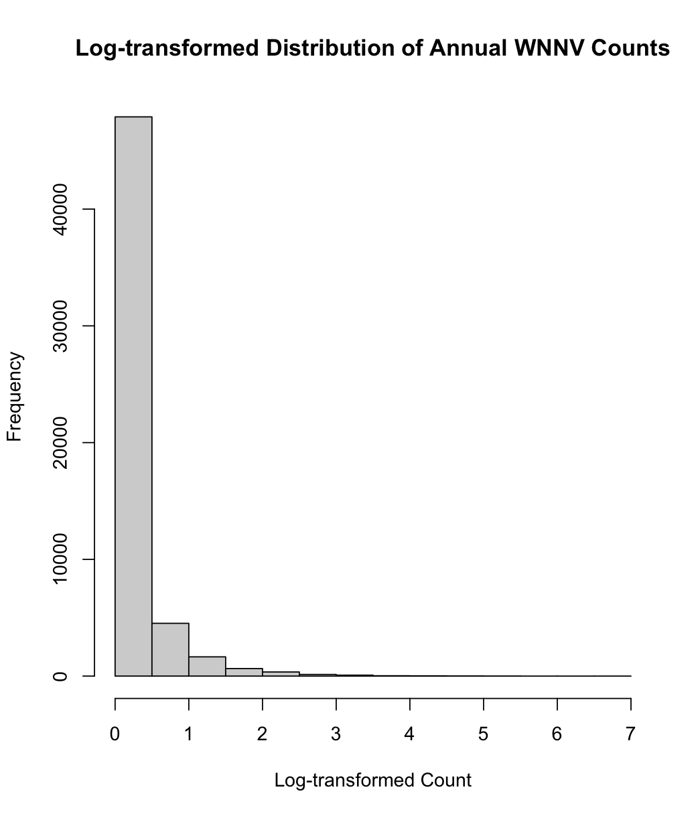
Chapter 3: WNV Prediction – Review Previous work
1. National-wise prediction with CDC data.
Issues:
Inconsistency in Data Collection
Significant Class Imbalance
Data Granularity in Human Data (only yearly, not weekly / monthly)
2. Solutions I tried:
Subsampling techniques to address class imbalance
Build Models on each state
Predict animal cases (horse, birds, mosquitoes)
Focus on the states which have better data granularity
Figure: WNV cases distribution

Slide 11
We tried many models for the national data prediction
Model | Description | Rationale for Selection | Pros | Cons
Random Forest | Ensemble learning, multiple decision trees | Robustness, handles non-linear data and missing data | Robust, handles missing values | Complex, reduced interpretability
SVM | Finds hyperplane separating classes in feature space | High-dimensional effectiveness | Performs well in high-dimensional spaces | Complex parameter tuning
Neural Network | Computing system for pattern recognition | Learns complex relationships | Exceptional pattern recognition | Proneness to overfitting, “black box”
Ensemble Model | Combines Random Forest with Autoregression | Leverages both strengths | Integrates spatial and temporal analysis | Constraints on temporal data structure
HistogramGBRT | Utilize decision trees built on a histogram-based discretization of continuous features | Efficiency, handle large datasets, regression and classification | Fast learning process, Robust, handles missing values | Complex,
SpatialGLMMs | Extend GLMs with spatially correlated random effects | Models' spatial correlation | Accurate spatial dependencies modeling | Complex interpretation
Notes:
Histogram-Based Binning is an efficient variant of gradient boosting machines (GBMs). Gradient boosting involves creating a predictive model by combining the predictions from multiple decision trees. The model starts with a base prediction (often the mean of the target variable for regression tasks) and sequentially adds new trees that predict the residuals or errors of the previous trees.
Unlike standard gradient boosting machines (GBMs) that consider every unique value when looking for the best split, HGBRT algorithms bin the continuous feature values into discrete bins, much like a histogram. This significantly reduces the number of potential splits to evaluate and speeds up the computation.
SGLMMs: Spatial Aspect: The "spatial" in SpatialGLMMs refers to the inclusion of spatial correlation among observations. This means that observations closer together are more likely to be similar than observations further apart.
SpatialGLMMs can model this with spatial random effects or by including a spatial correlation structure in the random effects.

Slide 12
National Model Does Not Work
Use subsampling to down-sample majority class (0 cases) for
both national and individual state
Original results for national disease count performance
Resampling results for national disease count performance
Model | MSE | Q²
Linear Regression | 82.82 | 0.07
Random Forest¹ | 84.28 | 0.05
HistogramGBRT¹ | 85.2 | 0.04
SVM | 80.5 | 0.09
Baseline Model ² | 88.8 | -1.05e-07
Model | MSE | Q²
Linear Regression | 314.90 | 0.08
Random Forest¹ | 325.12 | 0.05
HistogramGBRT¹ | 311.34 | 0.09
SVM | 309 | 0.09
1 The MSE and Q² is average results of 100 run
2 Always predict mean value
Notes:
Downsample the majority class by randomly selecting samples without replacement (replace=False) to match the size of the minority class.

Slide 13
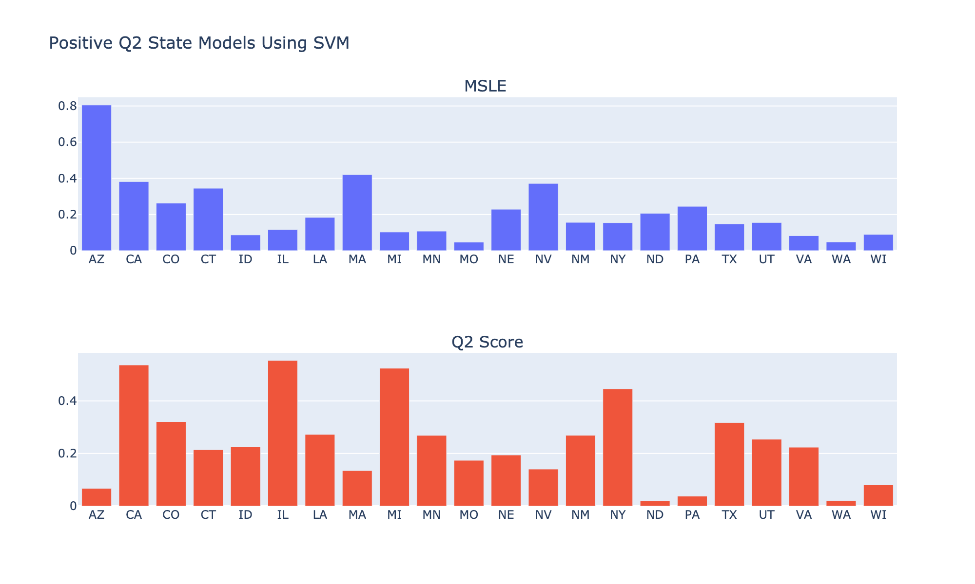
National Modeling for Individual States Shows Some States have Better Prediction
Same national data
Change from modeling the whole nation to modeling on each state
Figure: State models with positive Q²

Slide 14
We changed focus to California
Data
13 counties in California
Fresno, Kern, Los Angeles, Merced, Orange, Placer, Riverside, Sacramento, San Bernardino, San Joaquin, Solano, Stanislaus, Tulare
Source:
Web scraping from the CDPH website PDF files
Provided by California Department of Public Health Vector-Borne Disease Section

Slide 15
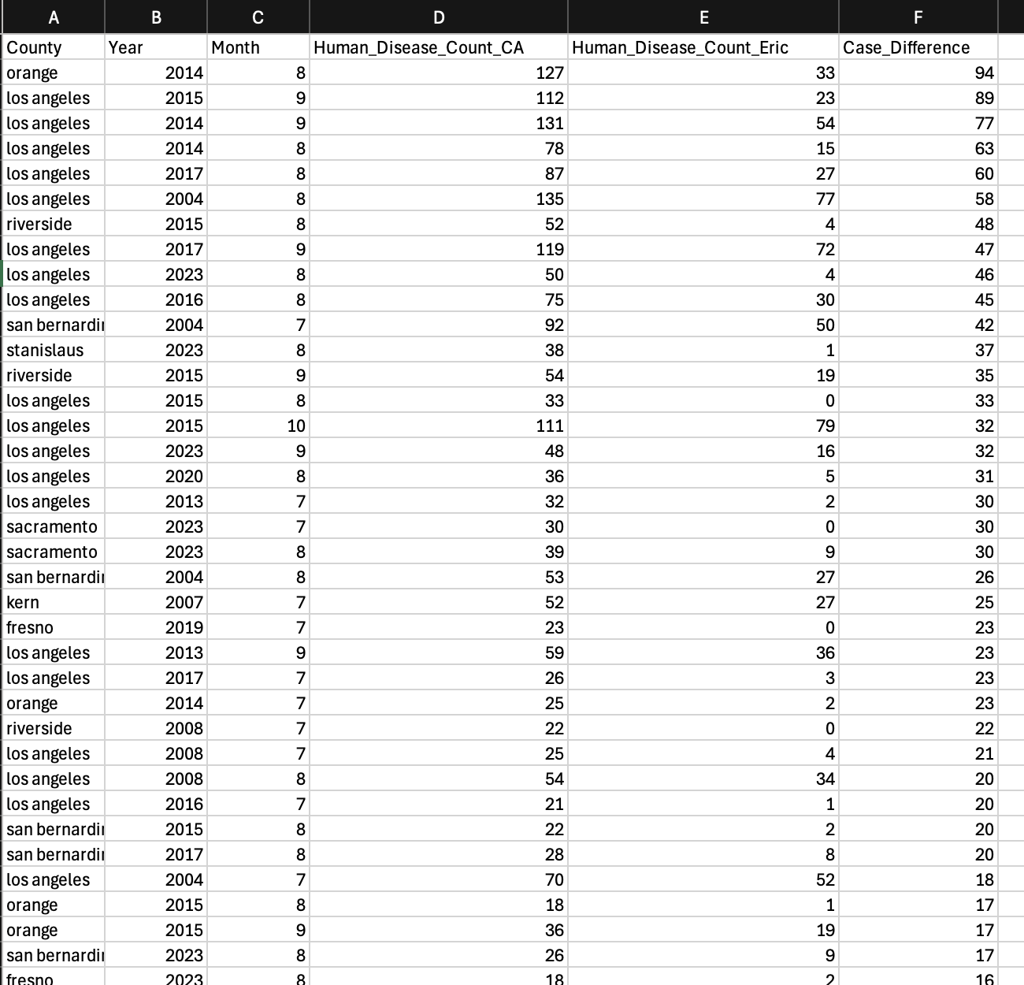
Different Data Sources Have a Lot of Variance
Dataset | Missing Data Ratio
CDPH – 13 counties, onset date | 71.92%
Web-scripting – 13 counties | 71.54%
Impute missing value to 0
Data Granularity: number of cases of
each month in each13 counties from 2004 to 2023

Slide 16
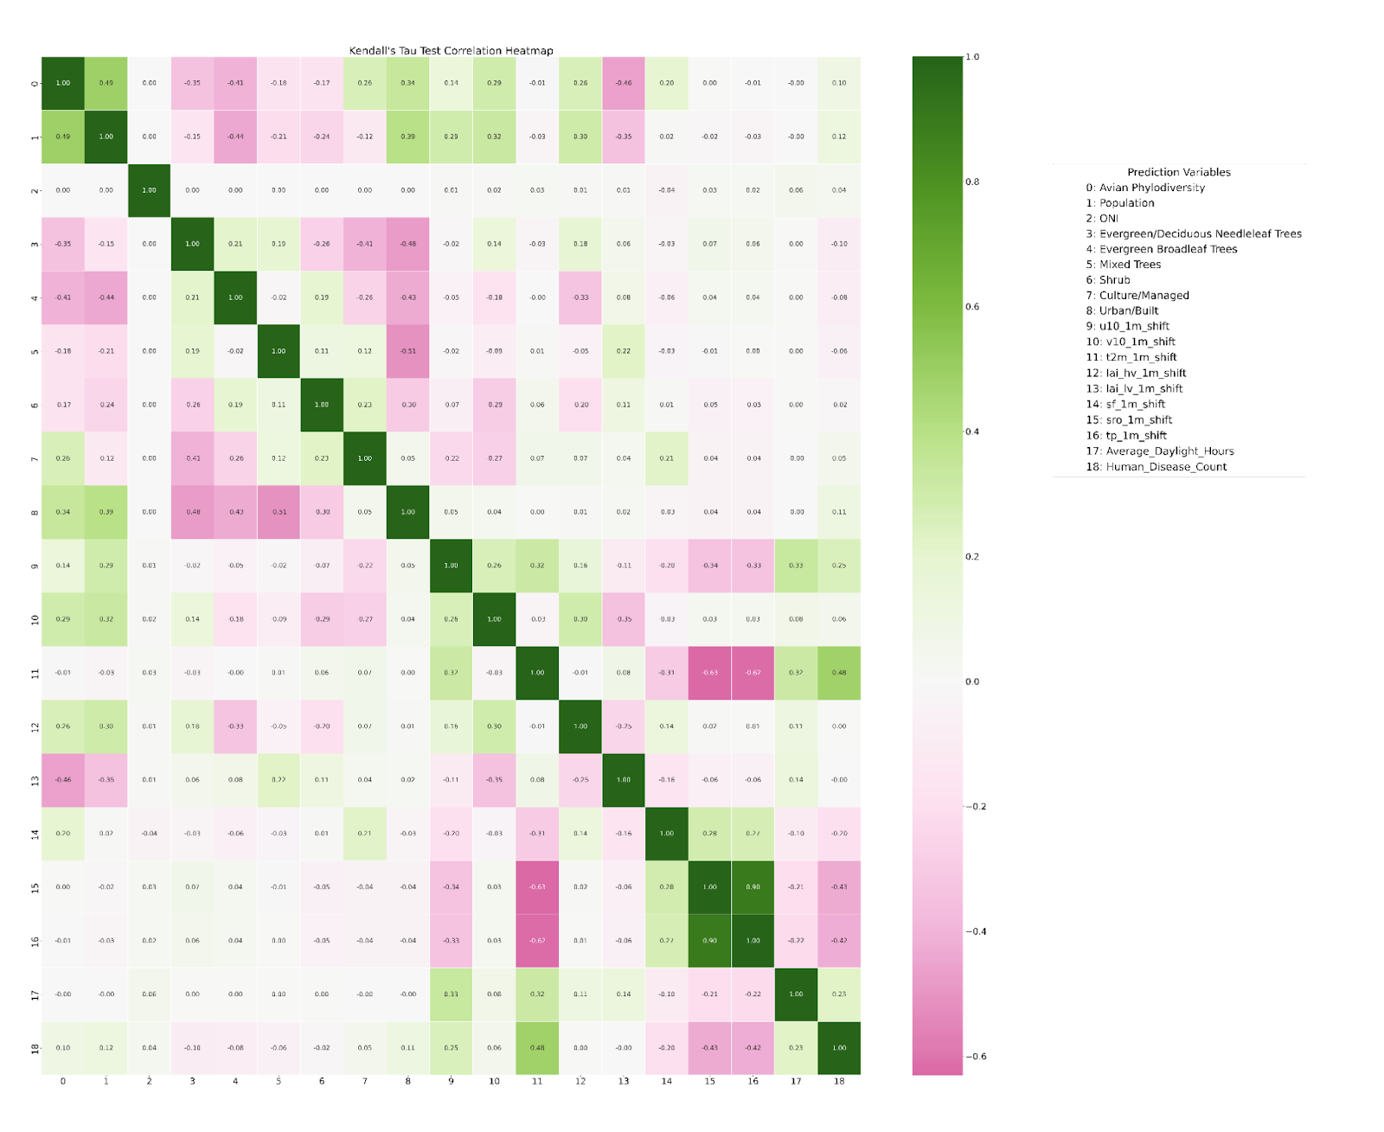
Correlations between Each Pair of Features
Prediction Variables
0: Avian Phylodiversity
1: Population
2: Oceanic Niño Index (ONI)
3: Evergreen/Deciduous Needleleaf Trees
4: Evergreen Broadleaf Trees
5: Mixed Trees
6: Shrub
7: Culture/Managed
8: Urban/Built
9: 10m eastward wind
10: 10m northward wind
11: Temperature
12: Leaf area index for high vegetation
13: Leaf area index for low vegetation
14: Snow fall
15: Surface runoff
16: Total precipitation
17: Average daylight hours
18: Human disease counts
Figure: Kendall’s Tau correlation between each pair of variables
0 1 2 3 4 5 6 7 8 9 10 11 12 13 14 15 16 17 18

Slide 17
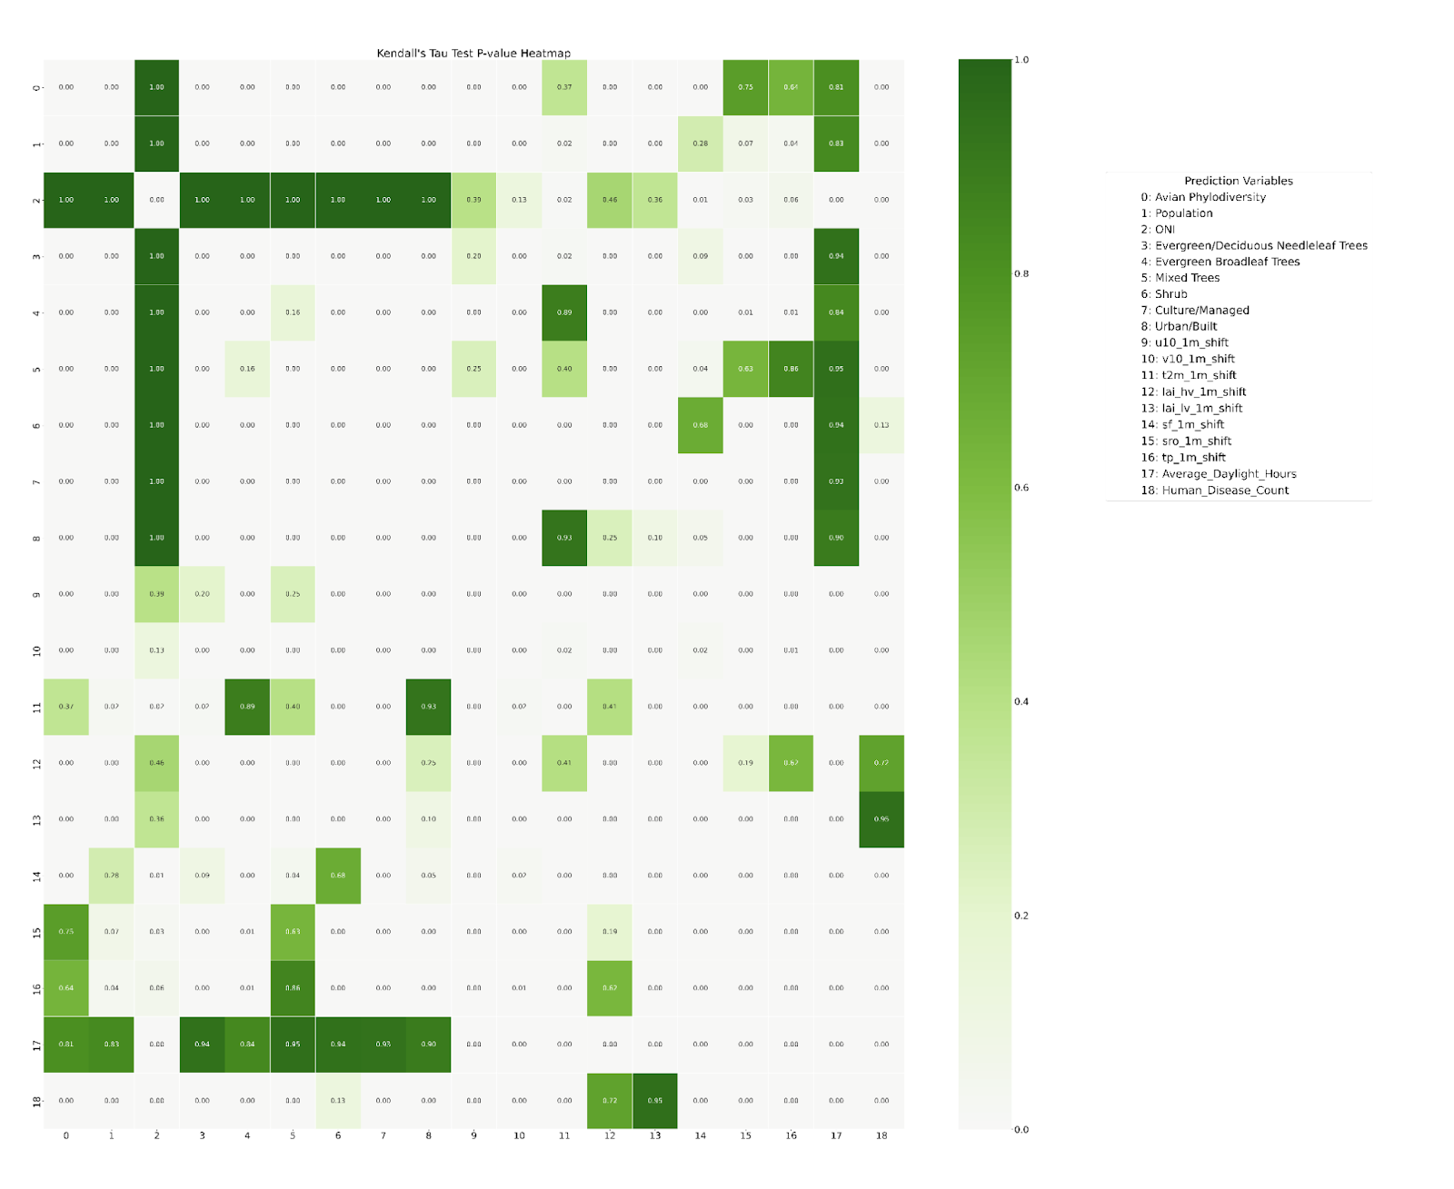
CDPH Data
Prediction Variables
0: Avian Phylodiversity
1: Population
2: Oceanic Niño Index (ONI)
3: Evergreen/Deciduous Needleleaf Trees
4: Evergreen Broadleaf Trees
5: Mixed Trees
6: Shrub
7: Culture/Managed
8: Urban/Built
9: 10m eastward wind
10: 10m northward wind
11: Temperature
12: Leaf area index for high vegetation
13: Leaf area index for low vegetation
14: Snow fall
15: Surface runoff
16: Total precipitation
17: Average daylight hours
18: Human disease counts
Kendall’s Tau p-value between each pair of variables

Slide 18
Correlations with Mosquito Abundance
Prediction Variables
0: Avian Phylodiversity
1: Population
2: Evergreen/Deciduous Needleleaf Trees
3: Evergreen Broadleaf Trees
4: Mixed Trees
5: Shrub
6: Culture/Managed
7: Urban/Built
8: 10m eastward wind
9: 10m northward wind
10: Temperature
11: Leaf area index for high vegetation
12: Leaf area index for low vegetation
13: Snow fall
14: Surface runoff
15: Total precipitation
16: Average daylight hours
17: Total mosquitoes' abundance
18: Human disease counts
Fig. Kendall’s Tau correlation between each pair of variables
0 1 2 3 4 5 6 7 8 9 10 11 12 13 14 15 16 17 18

Slide 19
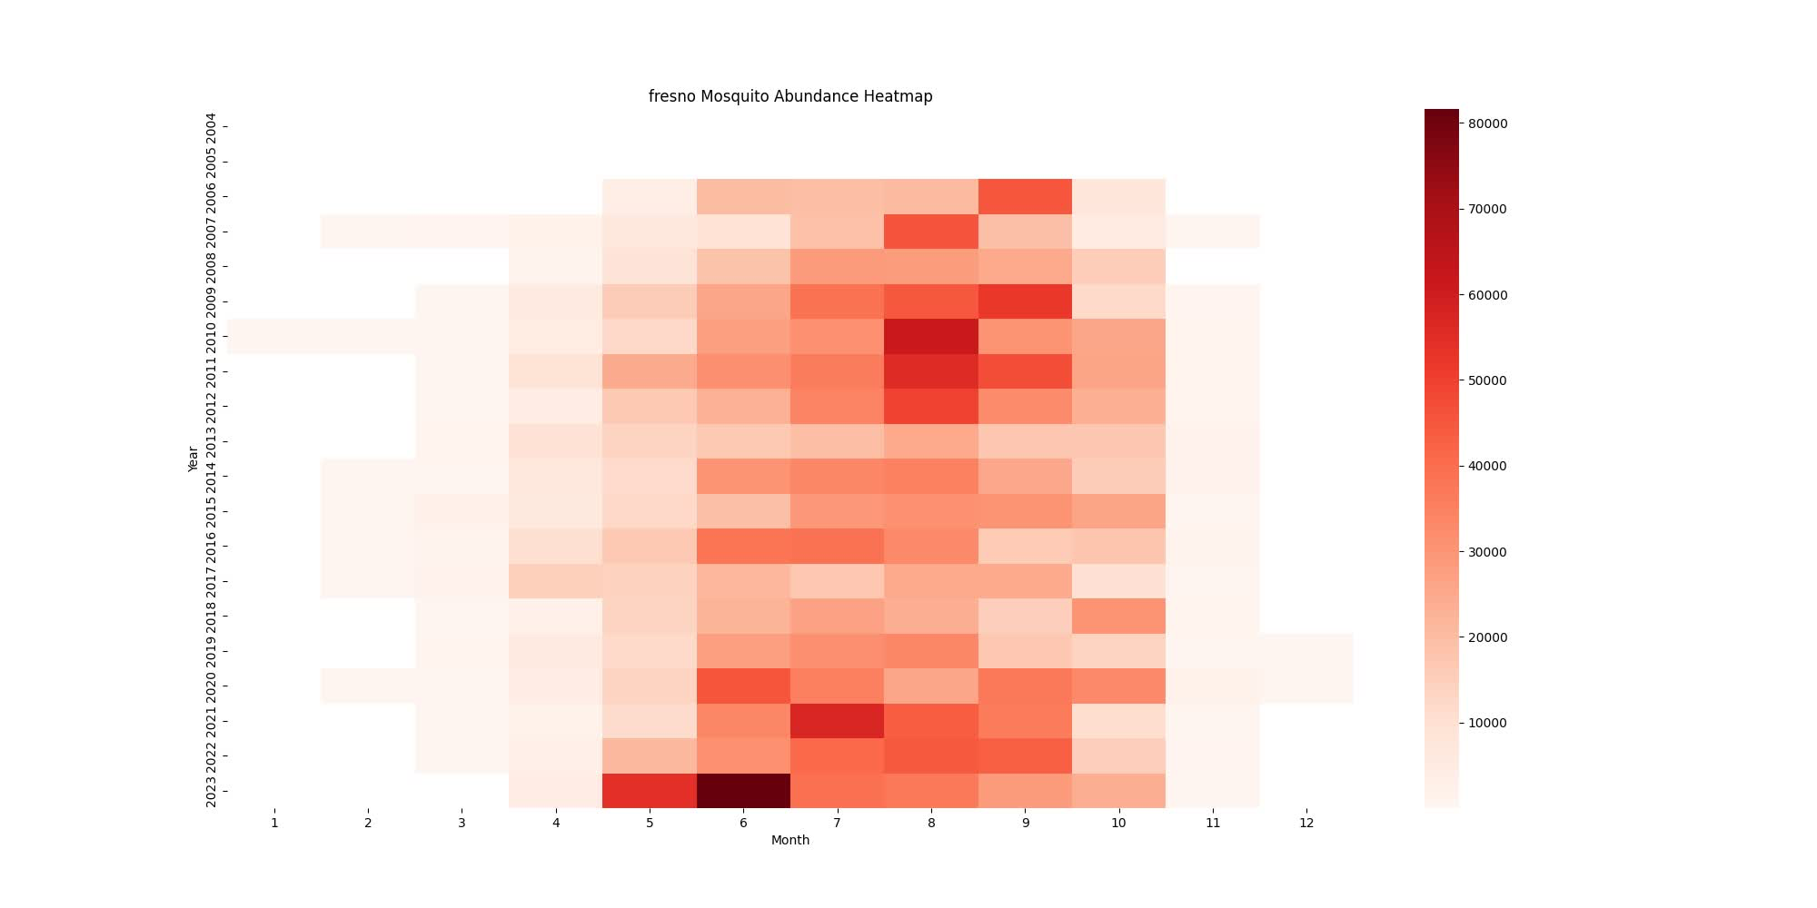
Mosquitoes Abundance Data Seems Incomplete in Early Years
Video: Heatmaps of mosquito abundance in each of the 13 counties of California for each month between 2004 and 2023

Slide 20
Which Years Capture the Best Patterns
Models:
SVM, RF, HGBR
Data choose:
Training data: 2004 → 2018
Testing data: 2019 → 2023
Hyperparameter tuning:
Building model to predict each year staring from 2005, use the previous years as training data, until finishing predict the data of year 2018.
Tune the hyperparameter for each model using grid search.
Choose the hyperparameter produce the best prediction as the final hyperparameter.
2004
2004, 2005
…
2004 2005, …, 2017
Predict
2005
2006
2018
…
Model 1
Model 2
Model …
Model 14
14 sets of hyperparameters
Notes:
svm

Slide 21
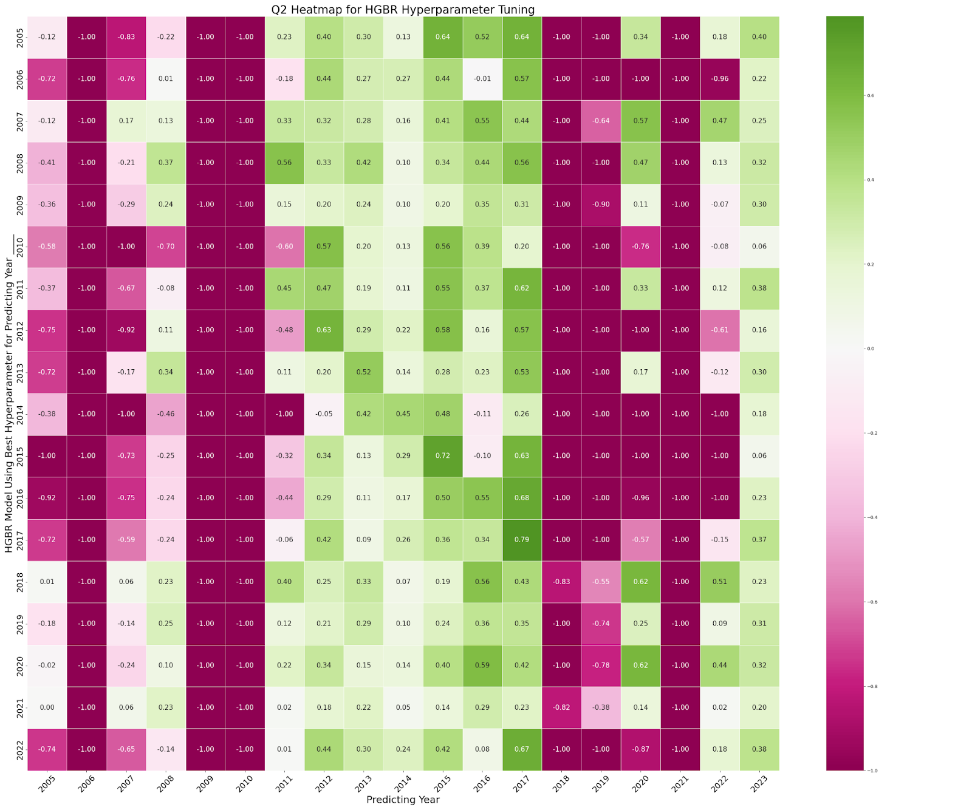
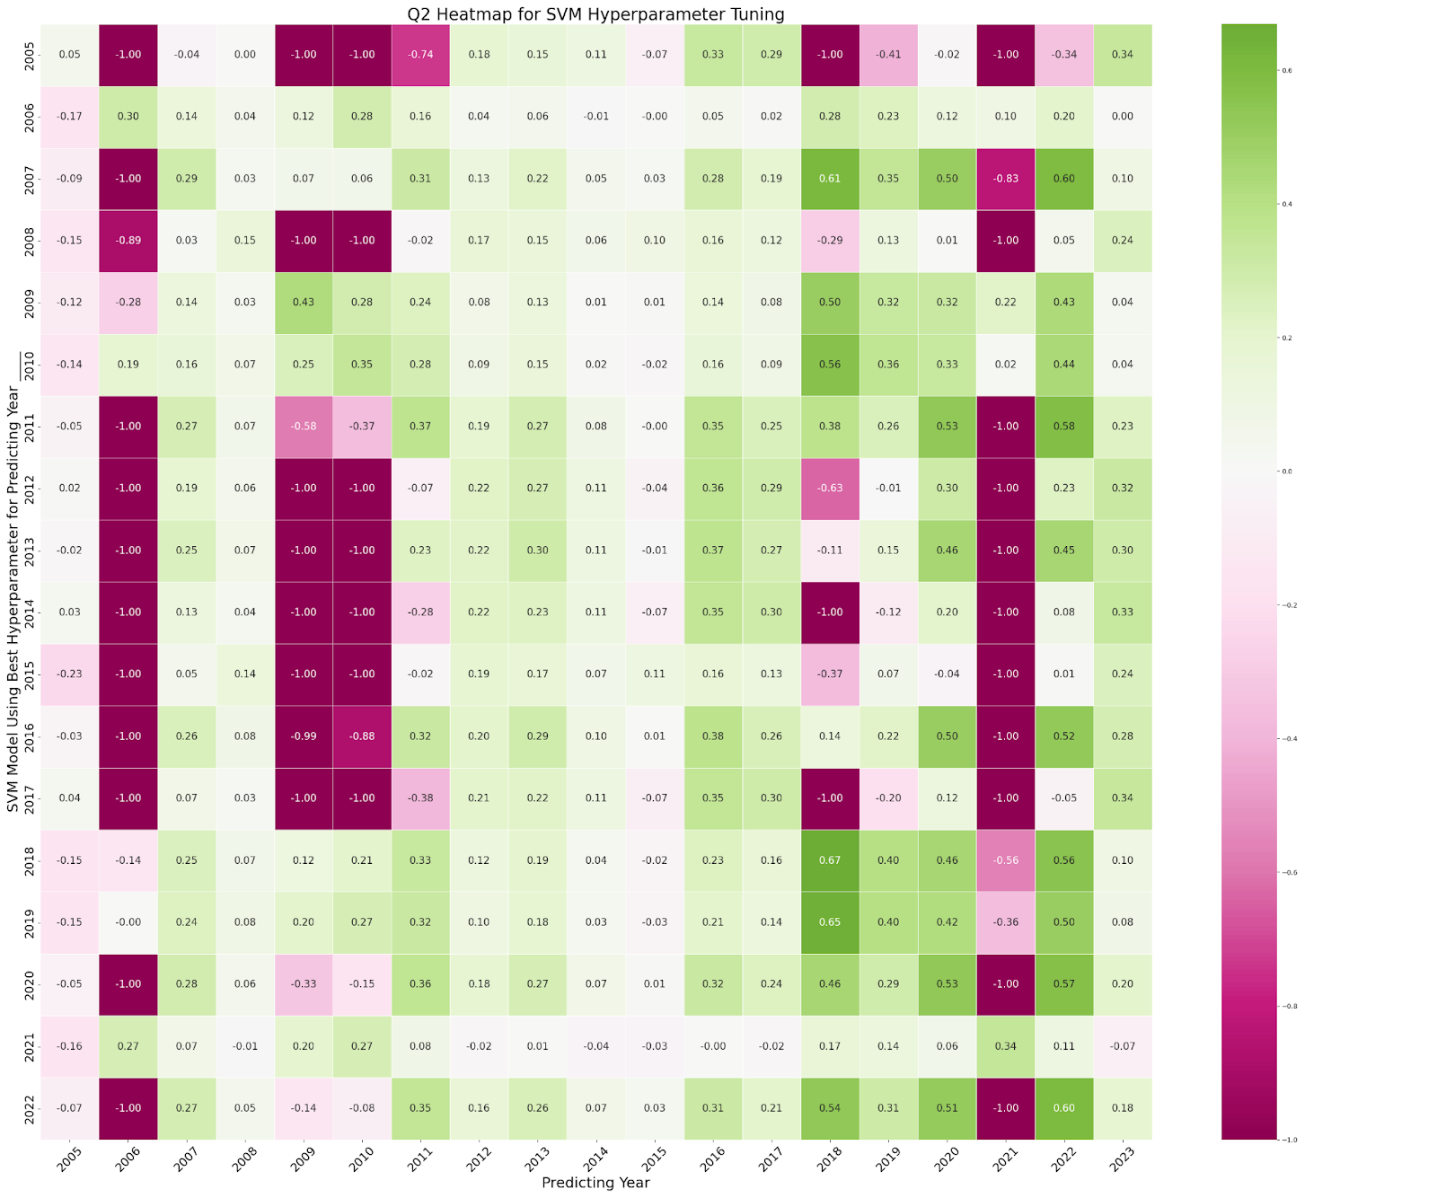
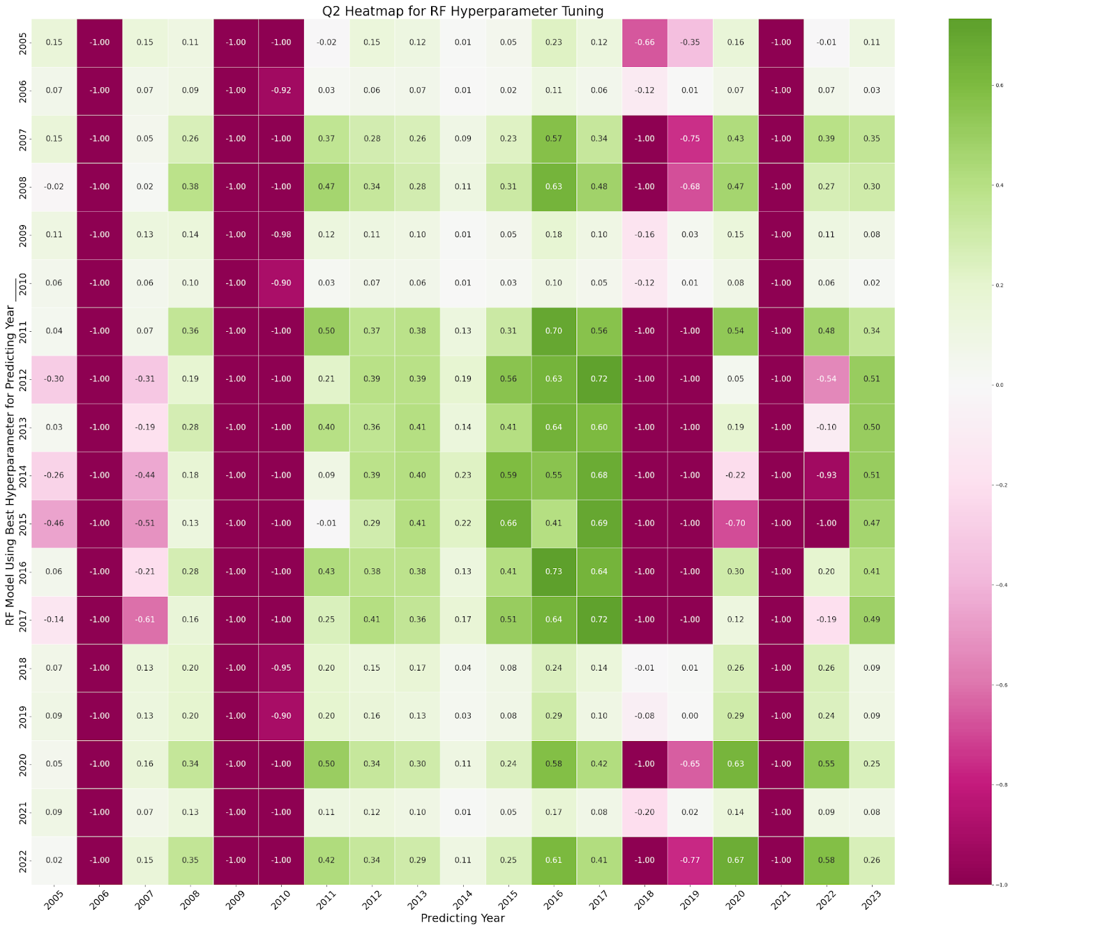
Year 2009 and 2018 Capture the Best Pattern in SVM
SVM
RF
HGBR
Figure: Q² results for each model
Notes:
Negative results. for predicting the result.
Not force the positive results but write what you can do with this data
The two best years might be the overfitting data.
what is the good about the year data recordings.
write a negative result paper.
2023 Paper of the London. Prediction Worldwide,
1. are you sure the test data we choose are legitment for using as testing data.

Slide 22
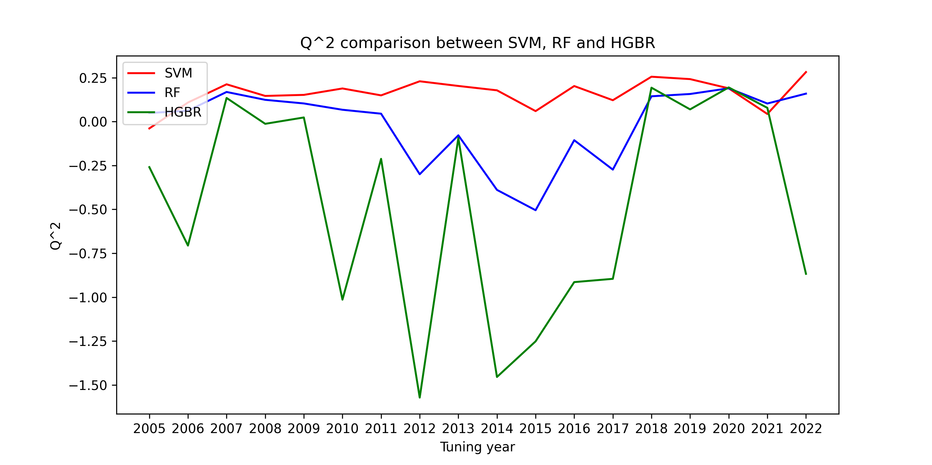
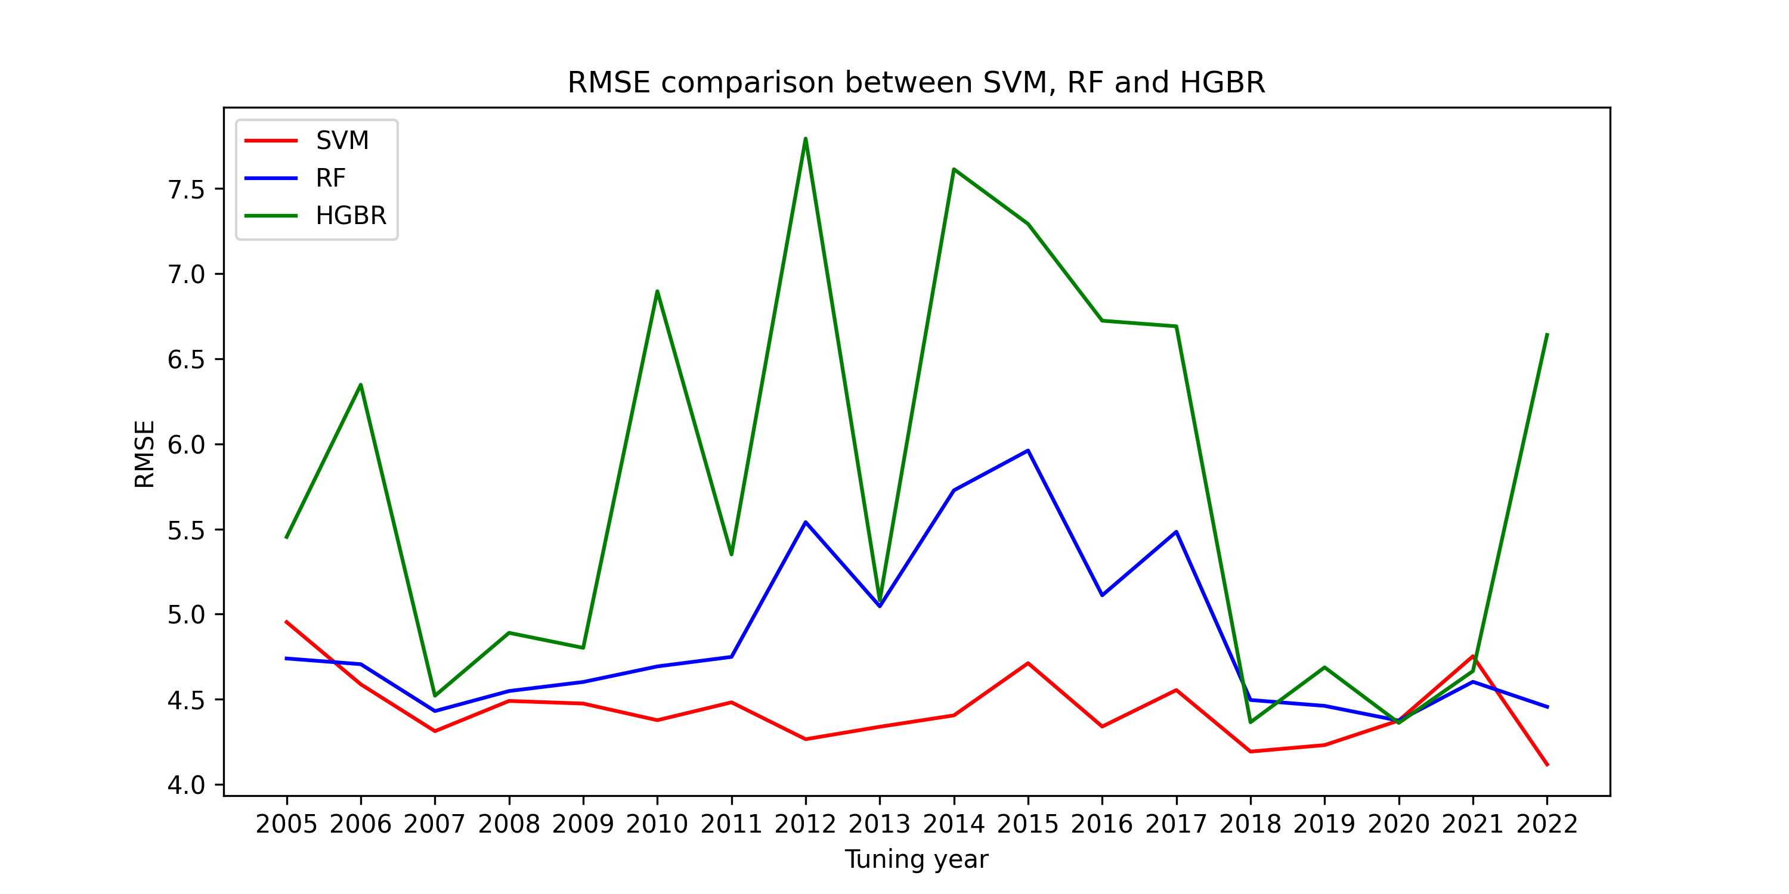
SVM Outperforms the Other Two Models
Figure: Q2 and RMSE results of Models of SVM, RF and HGBR
Notes:
1. Good points for data collecting recommendation.
demonstrate the data is working for the WNV to reporting. Maybe how to suggest the data collecting report!
2. Should adding the review of data collecting!
3. Explaining the model reusable.
Adding paragraphs to talk about how to make data accessible!
how can i accurate to make people to available to implement the models and data!

Slide 23
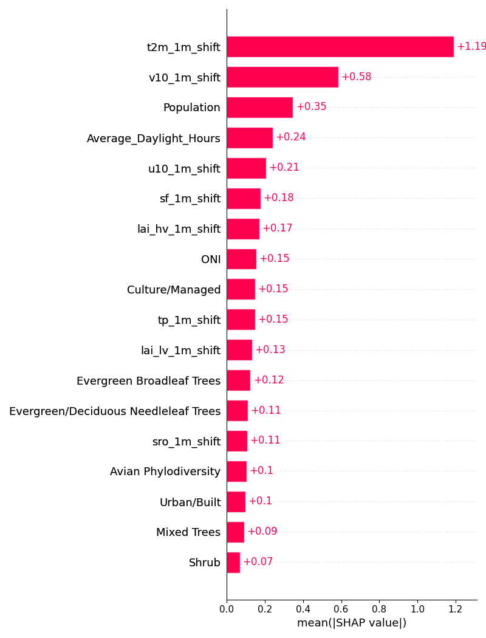
SHAP(SHapley Additive exPlanations) Shows the Importance of Individual Features
• SHAP is a game-theoretic approach to explain machine learning model predictions.
• Inspired by the Shapley value from cooperative game theory.
• Provides a fair way to allocate contributions of each feature to the model’s output.
• Positive SHAP values: Features that increase the prediction.
• Negative SHAP values: Features that decrease the prediction.
• All feature contributions sum up to the model’s prediction.
The global importance of each feature is taken to be the mean absolute value for that feature over all the given samples.
It reflects how much a feature contributes to the model’s predictions in magnitude, regardless of the direction.
Figure: Feature importance by using SHAP for SVM, global bar plot
Notes:
Easy Analogy:
The Team Project
• Prediction = Final Grade: Imagine a project grade.
• Features = Team Members: Each team member (feature) contributes to the grade.
• SHAP Values = Contribution Scores: SHAP tells you how much each member contributed to the final grade.

Slide 24
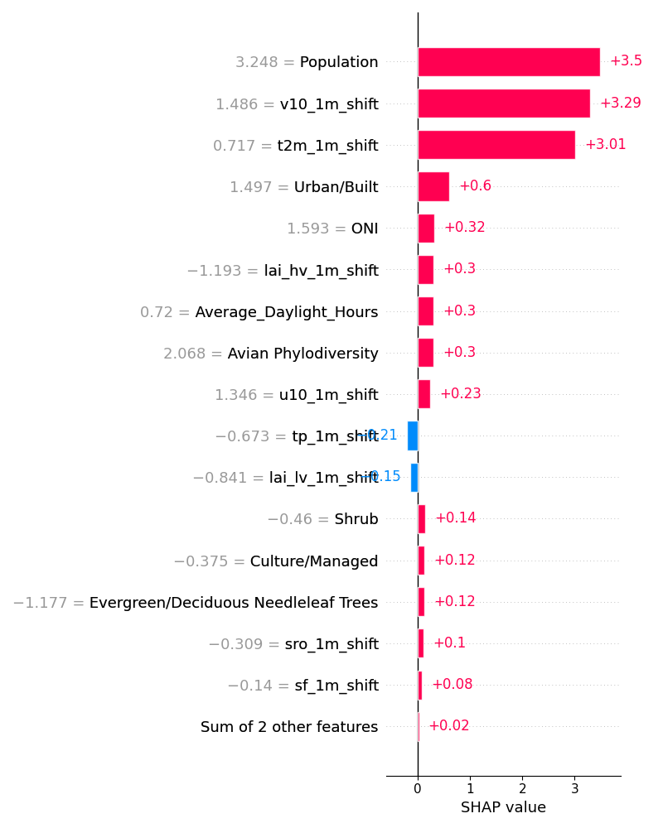
Local SHAP Allows to Explore the Underlying Causes of Outliers
FIPS | Month | Year | Human_Disease_Count | Predicted Values
6037 | 8 | 2023 | 50 | 13.2788492
6037 | 9 | 2023 | 48 | 10.784807
6067 | 8 | 2023 | 39 | 3.2940793
6099 | 8 | 2023 | 38 | 4.90537287
6037 | 8 | 2020 | 36 | 12.0877036
6067 | 7 | 2023 | 30 | 1.4182694
6037 | 9 | 2022 | 28 | 13.6115922
6071 | 8 | 2023 | 26 | 5.26843945
6067 | 9 | 2023 | 26 | 2.1469975
6037 | 9 | 2020 | 24 | 14.3301776
6019 | 7 | 2019 | 23 | 2.67373136
6019 | 8 | 2019 | 19 | 3.59617875
The final Prediction values = base value + contribution of each features
Loca SHAP plot for each individual sample
Notes:
Check the local SHAP value to see what is the good prediction sample

Slide 25
Key points for Chapter 3 Associated Paper
National prediction is not working
Different states show different predicting ability
California has good reporting and variation across the counties
California data has better prediction results and shows the driven variables, which are the variables to drive the population of the mosquitoes the most
Notes:
It seems the variables show up in CA driving the cases might show up in other states if they have better reporting
Why the data I collect is good, how can I find a better data to predict unless the magic model can predict it. What data need and what data has to be now to be able to collect to predict!
Adding more general information for slides to get interests

Slide 26
Key University Deadline
2025 spring academic calendar
Applying for graduation deadline: February 13, 2025
Doctoral dissertation defense deadline: April 9, 2025
Last day to submit doctoral dissertations: April 21, 2025

